Slide 1

Operating Systems
BCSC 0004
CPU Scheduling
Multilevel Queue Scheduling

Slide 2
Multilevel Queue Scheduling
Ready queue is partitioned into separate queues:
foreground (interactive)
background (batch)
Each queue has its own scheduling algorithm
  foreground – RR
  background – FCFS
Scheduling must be done between the queues
  Fixed priority scheduling; (i.e., serve all from foreground then from background). Possibility of starvation.
  Time slice – each queue gets a certain amount of CPU time which it can schedule amongst its processes; i.e., 80% to foreground in RR
  20% to background in FCFS

Slide 3
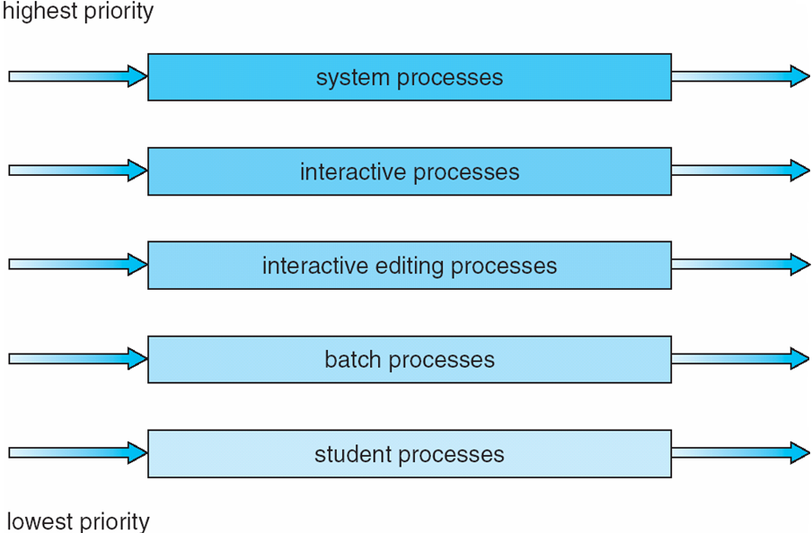
Multilevel Queues

Slide 4
Multilevel Feedback Queue
Low scheduling overhead but is inflexible: MQS
A process can move between the various queues; aging can be implemented this way (prevents starvation)
Multilevel-feedback-queue scheduler defined by the following parameters:
  number of queues
  scheduling algorithms for each queue
  method used to determine when to upgrade a process
  method used to determine when to demote a process
  method used to determine which queue a process will enter when that process needs service

Slide 5
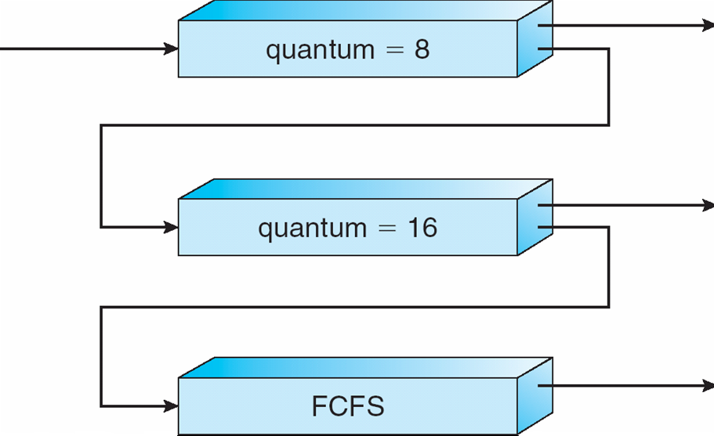
Multilevel Feedback Queue

Slide 6
Example
Three queues:
  Q₀ – RR with time quantum 8 milliseconds
  Q₁ – RR time quantum 16 milliseconds
  Q₂ – FCFS
Scheduling
  A new job enters queue Q₀ which is served FCFS. When it gains CPU, job receives 8 milliseconds. If it does not finish in 8 milliseconds, job is moved to queue Q₁.
  At Q₁ job is again served FCFS and receives 16 additional milliseconds. If it still does not complete, it is preempted and moved to queue Q₂.

Slide 7
Multiple-Processor Scheduling
CPU scheduling more complex when multiple CPUs are available
Homogeneous processors within a multiprocessor
Load sharing and Balancing
Asymmetric multiprocessing – only one processor accesses the system data structures, alleviating the need for data sharing
Symmetric multiprocessing (SMP) – each processor is self-scheduling, all processes in common ready queue, or each has its own private queue of ready processes
Processor affinity – process has affinity for processor on which it is currently running
  soft affinity
  hard affinity

Slide 8


